Slide 1

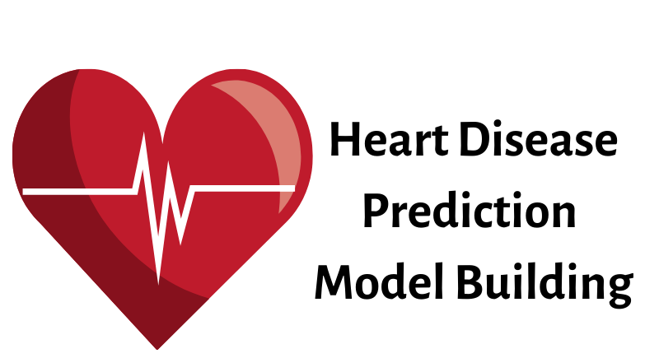
Indus Net Technologies Pvt. Ltd Heart Disease Prediction
By: Vaibhav Arora

Slide 2
PROJECT DETAIL
Project Title | Heart Disease Prediction
Domain | Healthcare
Programming Language Used | Python, HTML
Tools Used | Jupyter Notebook, MS-Excel, MS-Power BI, Visual Studio Code, Streamlit, PowerBI

Slide 3
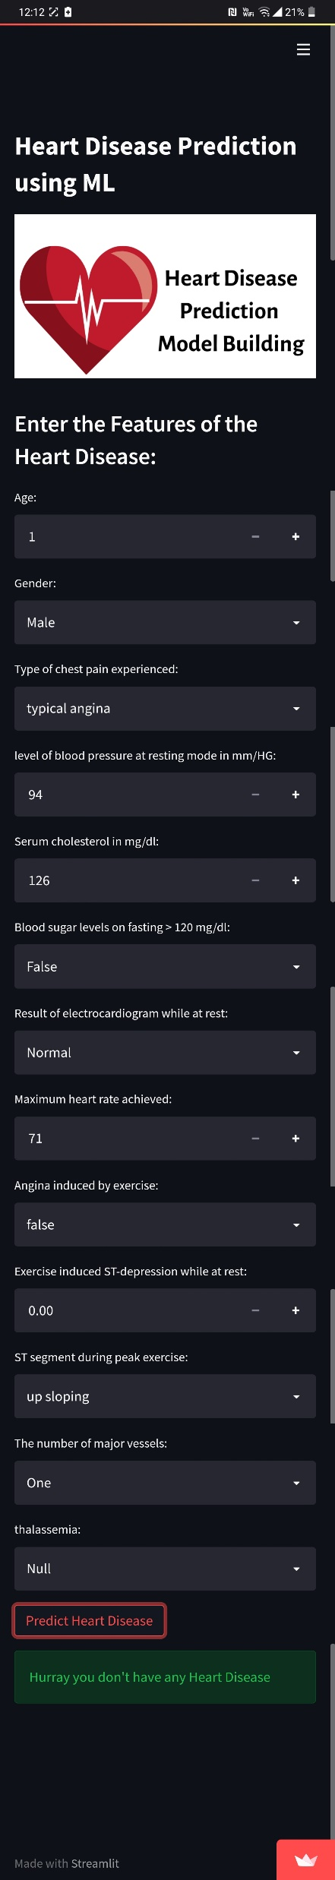
Deployment link: https://vaibhavarora13-int-heart-disease-20xt4b.streamlit.app/

Slide 4
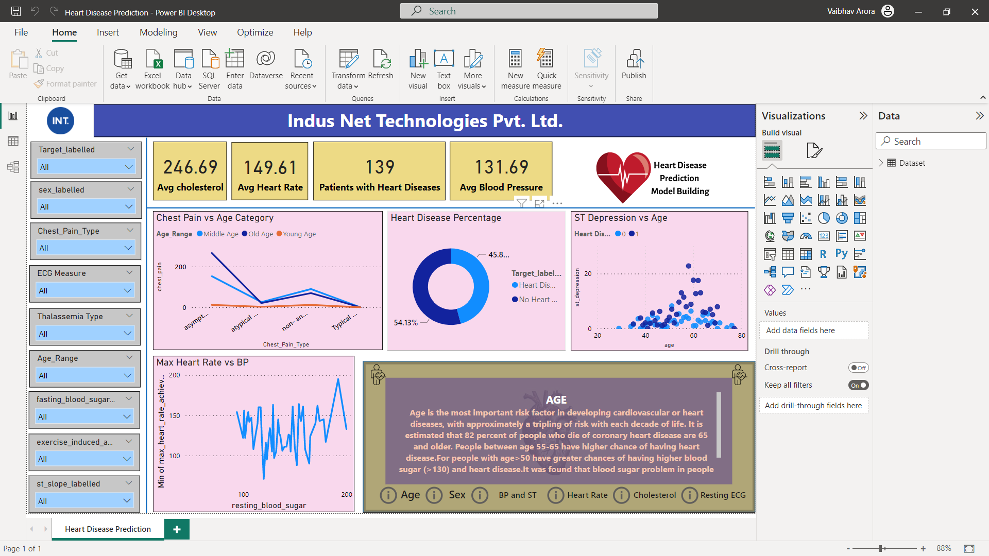
Power BI https://drive.google.com/file/d/1yDHX_CDwzpL3poAKuoW3Z12_gO_tmta2/view?usp=share_link

Slide 5
OBJECTIVE
The goal of this project is to analyze the heart disease occurrence, based on a combination of features that describes the heart disease.

Slide 6





PROBLEM STATEMENT
▶ Health is real wealth - In the pandemic time we all realized the brute effects of covid-19 on all irrespective of any status. You are required to analyse this health and medical data for better future preparation.
▶ A dataset is formed by taking into consideration some of the information of 303 individuals.

Slide 7
Dataset Information
This database contains 13 attributes and a target variable. It has 8 nominal values and 5 numeric values. The detailed description of all these features are as follows:
Age: Patients Age in years (Numeric)
Sex: Gender (Male : 1; Female : 0) (Nominal)
cp: Type of chest pain experienced by patient. This term categorized into 4 category. 0 typical angina, 1 atypical angina, 2 non- anginal pain, 3 asymptomatic (Nominal)
trestbps: patient's level of blood pressure at resting mode in mm/HG (Numerical)
chol: Serum cholesterol in mg/dl (Numeric)
fbs: Blood sugar levels on fasting > 120 mg/dl represents as 1 in case of true and 0 as false (Nominal)
restecg: Result of electrocardiogram while at rest are represented in 3 distinct values 0 : Normal 1: having ST-T wave abnormality (T wave inversions and/or ST elevation or depression of > 0.05 mV) 2: showing probable or definite left ventricular hypertrophyby Estes' criteria (Nominal)
thalach: Maximum heart rate achieved (Numeric)
exang: Angina induced by exercise 0 depicting NO 1 depicting Yes (Nominal)
oldpeak: Exercise induced ST-depression in relative with the state of rest (Numeric)
slope: ST segment measured in terms of slope during peak exercise 0: up sloping; 1: flat; 2: down sloping(Nominal)
ca: The number of major vessels (0–3)(nominal)
thal: A blood disorder called thalassemia 0: NULL 1: normal blood flow 2: fixed defect (no blood flow in some part of the heart) 3: reversible defect (a blood flow is observed but it is not normal(nominal)
target: It is the target variable which we have to predict 1 means patient is suffering from heart disease and 0 means patient is normal.

Slide 8
Age: Age is the most important risk factor in developing cardiovascular or heart diseases, with approximately a tripling of risk with each decade of life. Coronary fatty streaks can begin to form in adolescence. It is estimated that 82 percent of people who die of coronary heart disease are 65 and older. Simultaneously, the risk of stroke doubles every decade after age 55.
Sex: Men are at greater risk of heart disease than pre-menopausal women. Once past menopause, it has been argued that a woman's risk is similar to a man’s although more recent data from the WHO and UN disputes this. If a female has diabetes, she is more likely to develop heart disease than a male with diabetes.
Resting Blood Pressure: Over time, high blood pressure can damage arteries that feed your heart. High blood pressure that occurs with other conditions, such as obesity, high cholesterol or diabetes, increases your risk even more.
Why These Parameters are Important?
Fasting Blood Sugar: Not producing enough of a hormone secreted by your pancreas (insulin) or not responding to insulin properly causes your body's blood sugar levels to rise, increasing your risk of heart attack.
Cholesterol: A high level of low-density lipoprotein (LDL) cholesterol (the "bad" cholesterol) is most likely to narrow arteries. A high level of triglycerides, a type of blood fat related to your diet, also ups your risk of heart attack. However, a high level of high-density lipoprotein (HDL) cholesterol (the "good" cholesterol) lowers your risk of heart attack.
Resting ECG: For people at low risk of cardiovascular disease, the USPSTF concludes with moderate certainty that the potential harms of screening with resting or exercise ECG equal or exceed the potential benefits. For people at intermediate to high risk, current evidence is insufficient to assess the balance of benefits and harms of screening.
Max heart rate achieved: The increase in the cardiovascular risk, associated with the acceleration of heart rate, was comparable to the increase in risk observed with high blood pressure. It has been shown that an increase in heart rate by 10 beats per minute was associated with an increase in the risk of cardiac death by at least 20%, and this increase in the risk is similar to the one observed with an increase in systolic blood pressure by 10 mm Hg.
ST Depression: In unstable coronary artery disease, ST-segment depression is associated with a 100% increase in the occurrence of three-vessel/left main disease and to an increased risk of subsequent cardiac events. In these patients an early invasive strategy substantially decreases death/myocardial infarction.

Slide 9
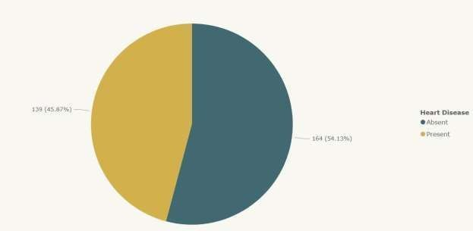
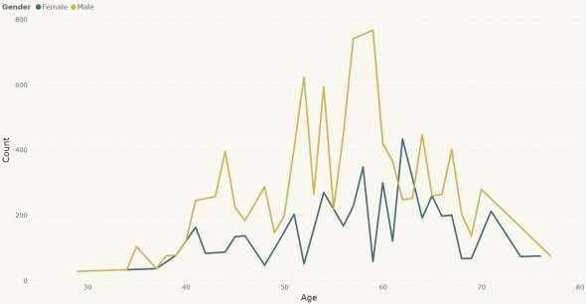
INSIGHTS
What Kind of Population do we have?
45.87% People suffering from heart disease.
More men are from age category >50 and
females are from category >55

Slide 10
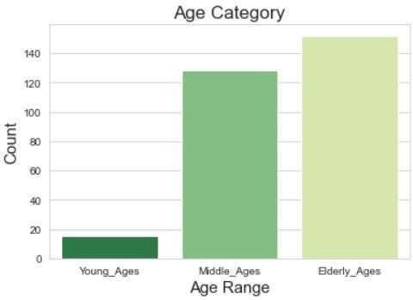
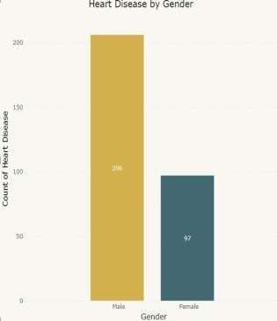
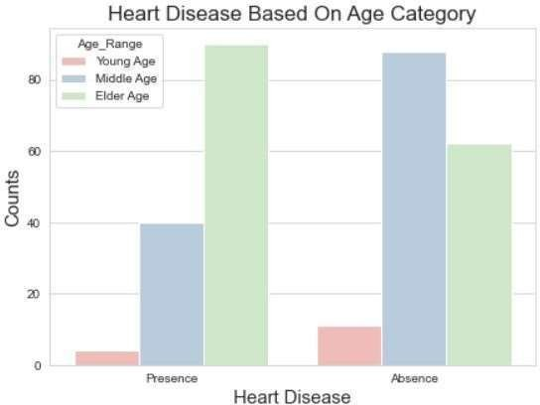
Who Suffers from Heart Disease?
Elderly Aged People (>55) are  Males are more prone to  Elderly Aged People (>55) are more in our population heart disease. more prone to heart disease.

Slide 11
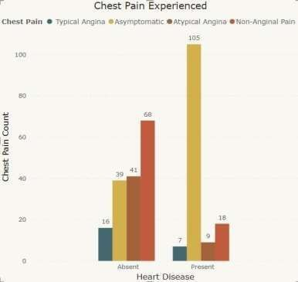
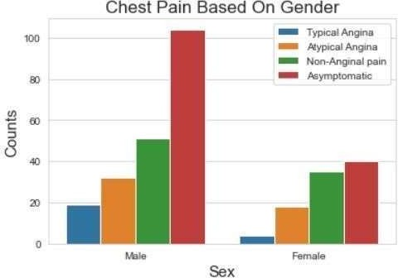
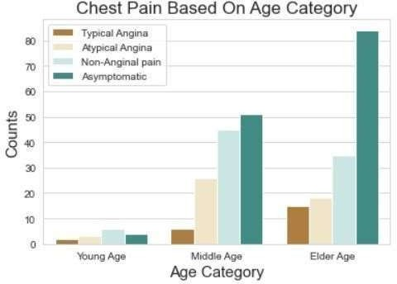
Chest Pain Experienced By Patients
It seems people having
asymptomatic chest pain have
○
○
We can see that a higher number of
men are suffering from
There is very high number of
Asymptomatic Pain in Elderly

Slide 12
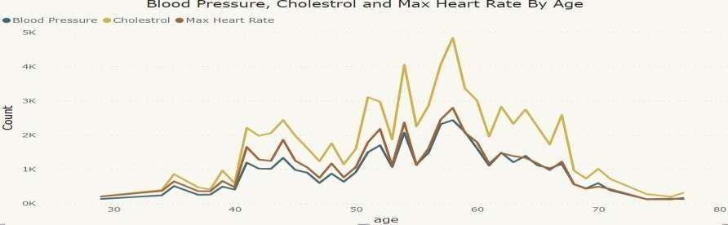
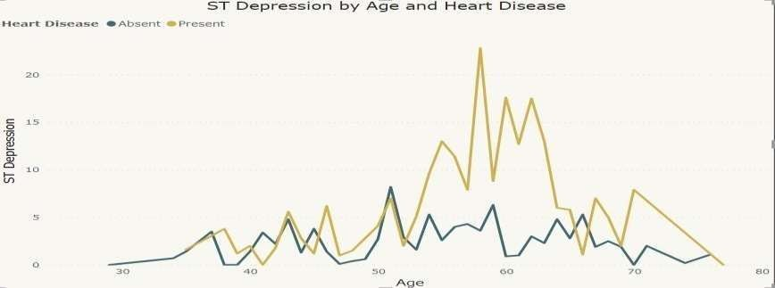
ST depression refers to a finding on an electrocardiogram, wherein the trace in the ST segment is abnormally low below the baseline.
Other symptoms people experience in heart disease:

Slide 13
Here we can observe that Blood Pressure increases between age of 50 to 60 and somehow continues
the pattern till 70.
Similarly, Cholesterol and maximum heart rate increases in the age group of 50-60.
We can observe from here that ST depression mostly increases between the age group of 30-40.

Slide 14
KEY PERFORMANCE INDICATOR (KPI)
Age Distribution including Gender.
Gender Distribution Based on Heart Disease.
Chest Pain Experienced by People Suffering from Heart Disease.
Blood Pressure, Cholesterol Level and Maximum Heart Rate of
People According to their Age and Heart Disease Patients.
ST Depression Experienced by People According to their age and heart disease.

Slide 15


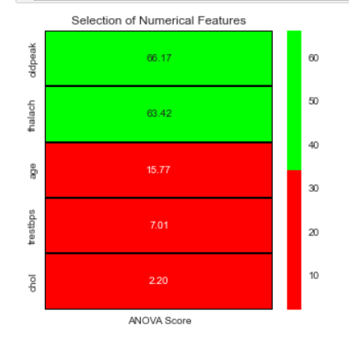
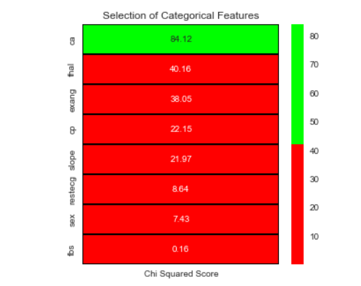
STATISTICAL TEST

Slide 16
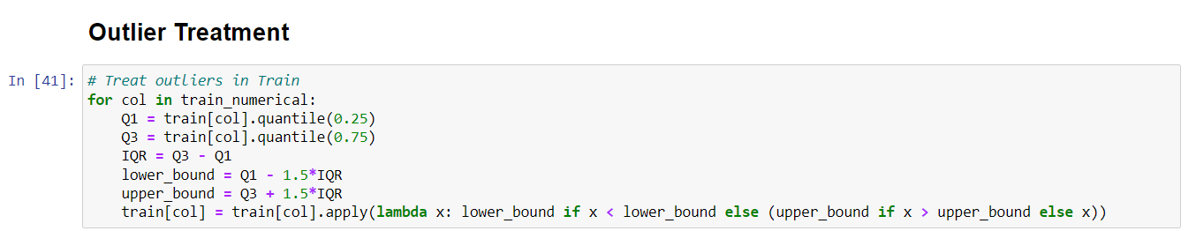
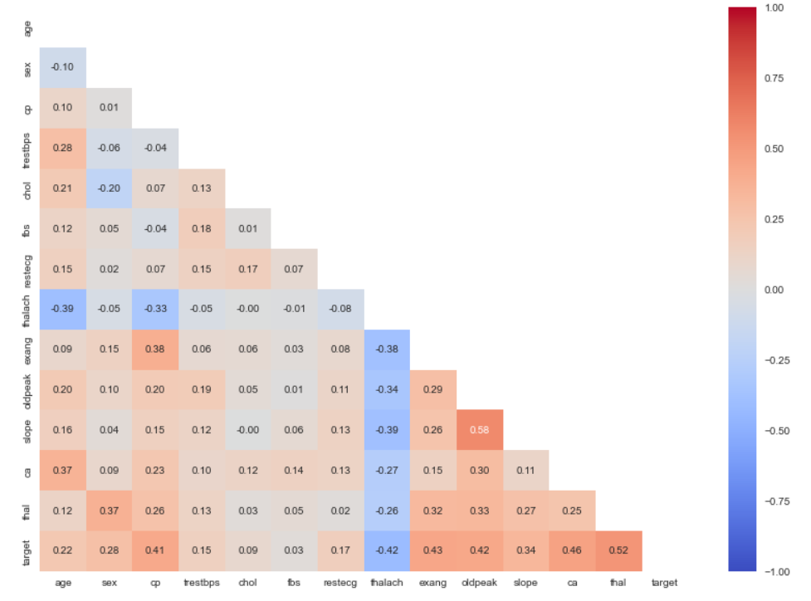
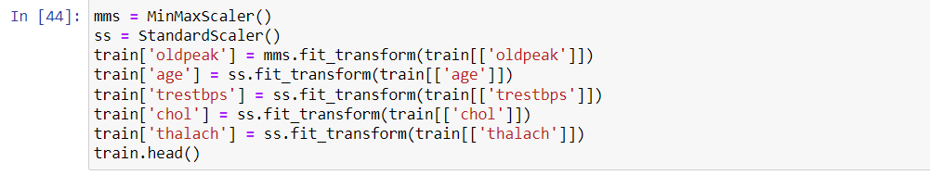
Pre-Processing

Slide 17
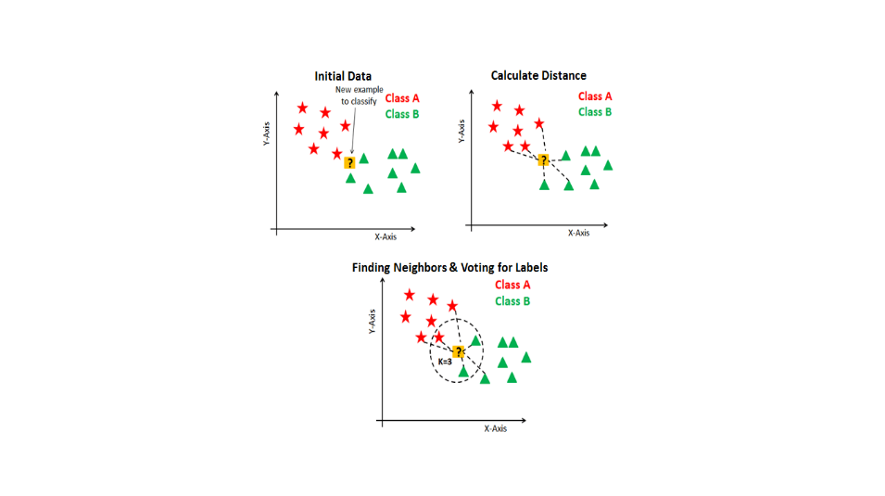
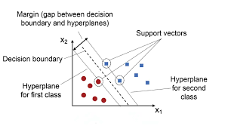
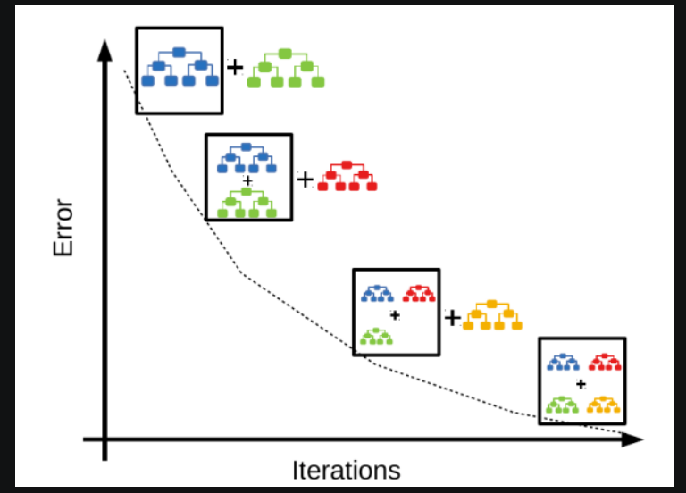
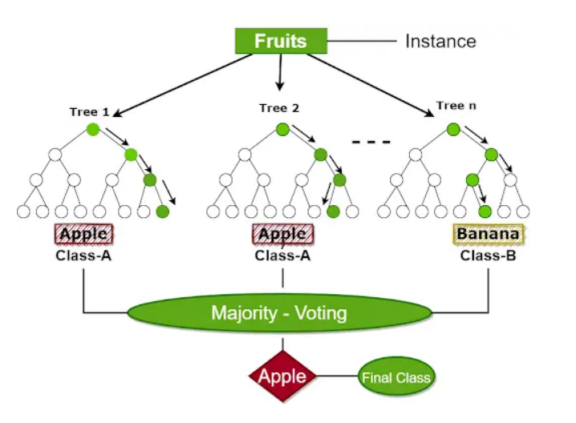
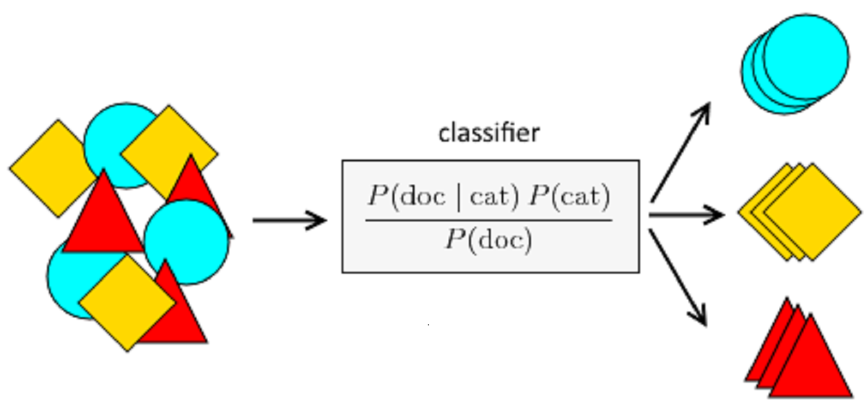
MODELLING
KNN
RANDOM FOREST

Slide 18
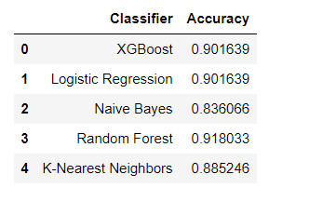
Model Comparison

Slide 19
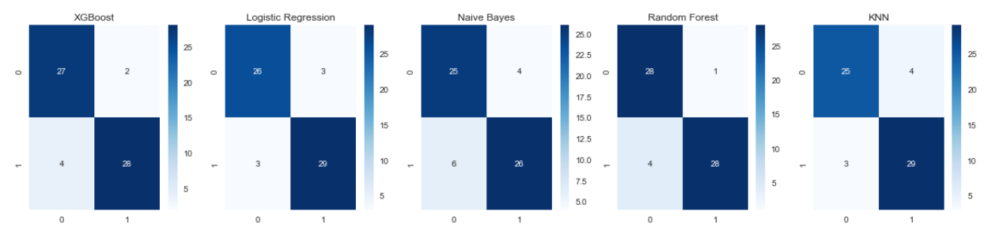
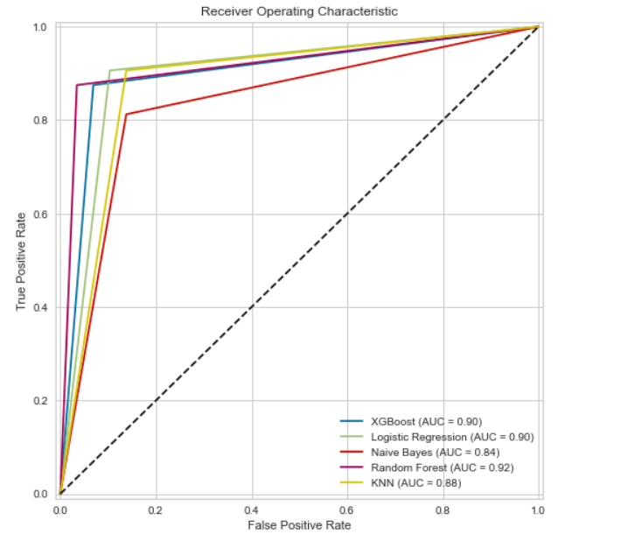
RESULTS

Slide 20
BEST MODEL
The Best Model came out is XGB which is not Overfit and Underfit

Slide 21
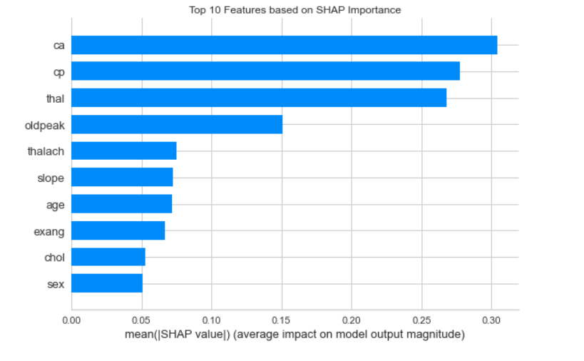
MODEL Interpretation by SHAP

Slide 22
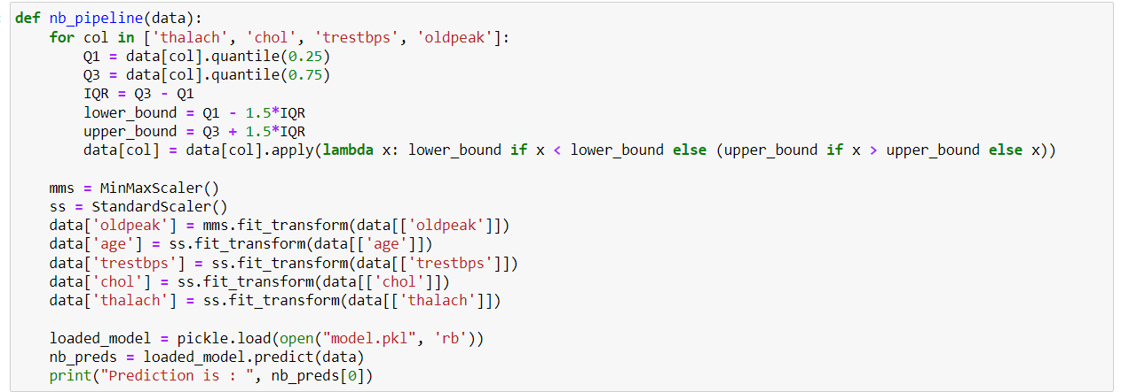
PIPELINE

Slide 23
THANK YOU

